Slide 1

Restaurant information system
Dương Thành Long
Phạm Lê Anh Khôi

Slide 2
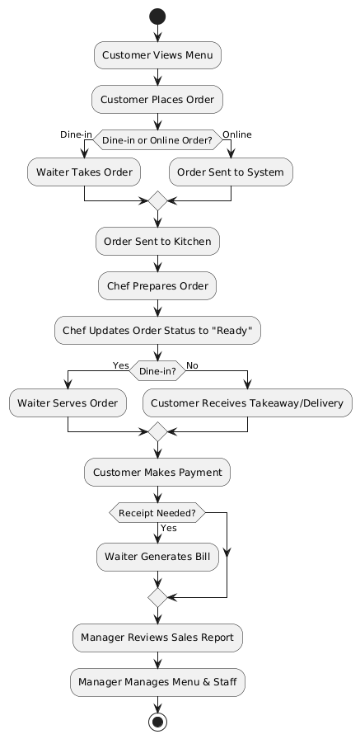
General WorkFlow

Slide 3
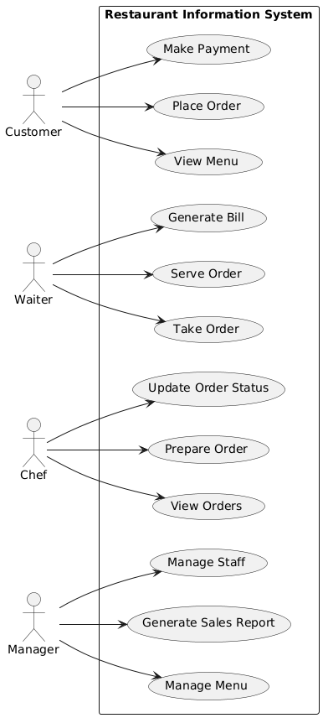
Use Case Diagram

Slide 4
Customer Use Cases
Use Case Name | View Menu
Scenario | Customer views the restaurant’s menu.
Triggering Event | Customer wants to browse available food items.
Brief Description | The customer accesses the restaurant system to view the menu, which displays available dishes, prices, and descriptions.
Actors | Customer
Related Use Cases | Place Order
Stakeholders | Customers, Marketing, Sales
Preconditions | Menu data must be available in the system.
Postconditions | Customer can view menu details.
Flow of Activities | Actor 1. Customer requests to view the menu. | System 1.1 System retrieves menu items. 1.2 System displays menu with item descriptions and prices.
Exception Conditions | 1.1 Menu data is unavailable or system error occurs.

Slide 5
Customer Use Cases
Use Case Name | Place Order
Scenario | Customer places a food order.
Triggering Event | Customer selects food items and proceeds to order.
Brief Description | The customer selects food items from the menu and places an order, which is sent to the kitchen for preparation.
Actors | Customer
Related Use Cases | View Menu, Make Payment
Stakeholders | Customers, Kitchen Staff, Waiters
Preconditions | The menu must be available, and the restaurant must be accepting orders.
Postconditions | Order is saved in the system and sent to the kitchen.
Flow of Activities | Actor Customer selects items from the menu. Customer confirms order. | System 1.1 System adds items to order. 2.1 System validates the order and calculates total cost. 2.2 System generates an order ID and sends it to the kitchen.
Exception Conditions | 1. Selected menu item is unavailable. 2. System fails to validate order (e.g., incorrect quantity).

Slide 6
Customer Use Cases
Use Case Name | Make Payment
Scenario | Customer completes payment for an order.
Triggering Event | Customer decides to pay for their order.
Brief Description | The customer selects a payment method and completes the transaction.
Actors | Customer
Related Use Cases | Place Order
Stakeholders | Customers, Accounting
Preconditions | A valid order must exist.
Postconditions | Payment is processed and recorded.
Flow of Activities | Actor Customer requests bill. Customer selects payment method and enters details. | System 1.1 System generates the bill and displays payment options. 2.1 System processes payment via the selected method. 2.2 System confirms payment and generates receipt.
Exception Conditions | 1. Payment fails due to insufficient funds or network issues.

Slide 7
Waiter Use Cases
Use Case Name | Take Order
Scenario | Waiter takes a customer’s order.
Triggering Event | Customer provides order details to the waiter.
Brief Description | The waiter inputs the customer’s order into the system, which then sends it to the kitchen.
Actors | Waiter
Related Use Cases | Place Order, Prepare Order
Stakeholders | Customers, Kitchen Staff, Waiters
Preconditions | The restaurant must be open and accepting orders.
Postconditions | The order is registered in the system and sent to the kitchen.
Flow of Activities | Actor 1. Waiter inputs the customer’s order. | System 1.1 System saves the order and assigns an order ID. 1.2 System sends the order to the kitchen.
Exception Conditions | 1. System fails to register the order.

Slide 8
Waiter Use Cases
Use Case Name | Serve Order
Scenario | Waiter serves the prepared order to the customer.
Triggering Event | The kitchen completes an order.
Brief Description | When food is ready, the waiter picks up the order and serves it to the customer.
Actors | Waiter
Related Use Cases | Prepare Order
Stakeholders | Customers, Kitchen Staff
Preconditions | The order must be prepared and ready.
Postconditions | The customer receives their order.
Flow of Activities | Actor Waiter checks if the order is ready. Waiter picks up the order and delivers it. | System 1.1 System displays order status. 2.1 System updates order status to "Served".
Exception Conditions | 1. Order status is incorrect or missing.

Slide 9
Waiter Use Cases
Use Case Name | Generate Bill
Scenario | System generates a bill for the customer.
Triggering Event | Customer requests the bill.
Brief Description | The waiter or system generates a bill based on the customer’s order.
Actors | Waiter, Customer
Related Use Cases | Make Payment
Stakeholders | Customers, Accounting
Preconditions | The order must exist.
Postconditions | The customer receives the bill.
Flow of Activities | Actor 1. Customer requests the bill. | System 1.1 System retrieves order details. 1.2 System calculates the total amount. 1.3 System generates and displays the bill.
Exception Conditions | 1. Order details are missing or incorrect.

Slide 10
Chef Use Cases
Use Case Name | View Order
Scenario | Chef checks the list of received orders.
Triggering Event | Chef wants to see the pending orders to prepare them.
Brief Description | The system retrieves and displays a list of orders for the chef, including details such as items ordered, quantity, and special requests.
Actors | Chef
Related Use Cases | Update Order Status
Stakeholders | Kitchen Staff, Management
Preconditions | There must be at least one pending order in the system.
Postconditions | The chef can see the order details and proceed with preparation.
Flow of Activities | Actor 1. Chef requests to view pending orders. | System 1.1 System retrieves a list of pending orders. 1.2 System displays the order details.
Exception Conditions | 1. No pending orders exist.

Slide 11
Chef Use Cases
Use Case Name | Prepare Order
Scenario | Chef prepares the customer’s order.
Triggering Event | The system sends a new order to the kitchen.
Brief Description | The chef receives and prepares the order before notifying staff that it is ready.
Actors | Chef
Related Use Cases | Take Order, Serve Order
Stakeholders | Customers, Kitchen Staff
Preconditions | The order must exist in the system.
Postconditions | The order is marked as ready for serving.
Flow of Activities | Actor 1. Chef views pending orders. 2. Chef prepares the order. 3. Chef finishes preparation. | System 1.1 System displays orders marked as "Pending". 2.1 System updates order status to "In Progress". 3.1 System marks order as "Ready".
Exception Conditions | 1. System does not display pending orders.

Slide 12
Chef Use Cases
Use Case Name | Update Order Status
Scenario | Chef updates the order status.
Triggering Event | Chef needs to update the status of an order (e.g., from "In Progress" to "Ready").
Brief Description | The order status is updated by the chef, and the system reflects the change.
Actors | Chef
Related Use Cases | Prepare Order, Serve Order, View Order
Stakeholders | Customers, Kitchen Staff, Waiters
Preconditions | The order must exist and have a valid status.
Postconditions | Order status is updated in the system.
Flow of Activities | Actor Chef selects an order. Chef updates the order status. | System 1.1 System retrieves order details 2.1 System updates order status accordingly..
Exception Conditions | Order does not exist. System fails to update order status due to an error.

Slide 13
Manage Use Cases
Use Case Name | Manage Staff
Scenario | Manager adds, updates, or removes staff members.
Triggering Event | The Manager needs to modify staff information.
Brief Description | The Manager can add new staff, update existing staff details, or remove staff from the system.
Actors | Manager
Related Use Cases | None
Stakeholders | HR, Management
Preconditions | The system must have valid authentication for the manager.
Postconditions | Staff data is updated in the system.
Flow of Activities | Actor Manager selects "Manage Staff". Manager selects an action (Add/Update/Remove). | System 1.1 System displays staff list and options (Add, Update, Remove). 2. 1 Manager selects an action (Add/Update/Remove).
Exception Conditions | Manager selects an action (Add/Update/Remove). System fails to update records.

Slide 14
Manager Use Cases
Use Case Name | Manage Menu
Scenario | Manager updates the restaurant menu.
Triggering Event | Manager needs to modify menu items.
Brief Description | The Manager can add new menu items, update existing ones, or remove items from the menu.
Actors | Manager
Related Use Cases | View Menu
Stakeholders | Customers, Management
Preconditions | The system must authenticate the manager.
Postconditions | The menu is updated in the system.
Flow of Activities | Actor Manager selects "Manage Menu". 2. Manager selects an action (Add/Update/Remove). | System 1.1 System displays menu list and options (Add, Update, Remove). 2.1 System processes the request and updates menu records.
Exception Conditions | Menu data is incomplete or invalid. System fails to update menu records.

Slide 15
Manager Use Cases
Use Case Name | Generate Sales Report
Scenario | Manager generates a report of sales.
Triggering Event | Manager wants to view a summary of sales data.
Brief Description | The system compiles and displays a report summarizing sales over a specified period.
Actors | Manager
Related Use Cases | Make Payment
Stakeholders | Accounting, Management
Preconditions | Sales data must exist in the system.
Postconditions | A sales report is generated.
Flow of Activities | Actor 1. Manager requests a sales report. | System 1.1 System retrieves sales data. 1.2 System compiles the data into a report. 1.3 System displays the report.
Exception Conditions | No sales data available. System error prevents report generation.

Slide 16
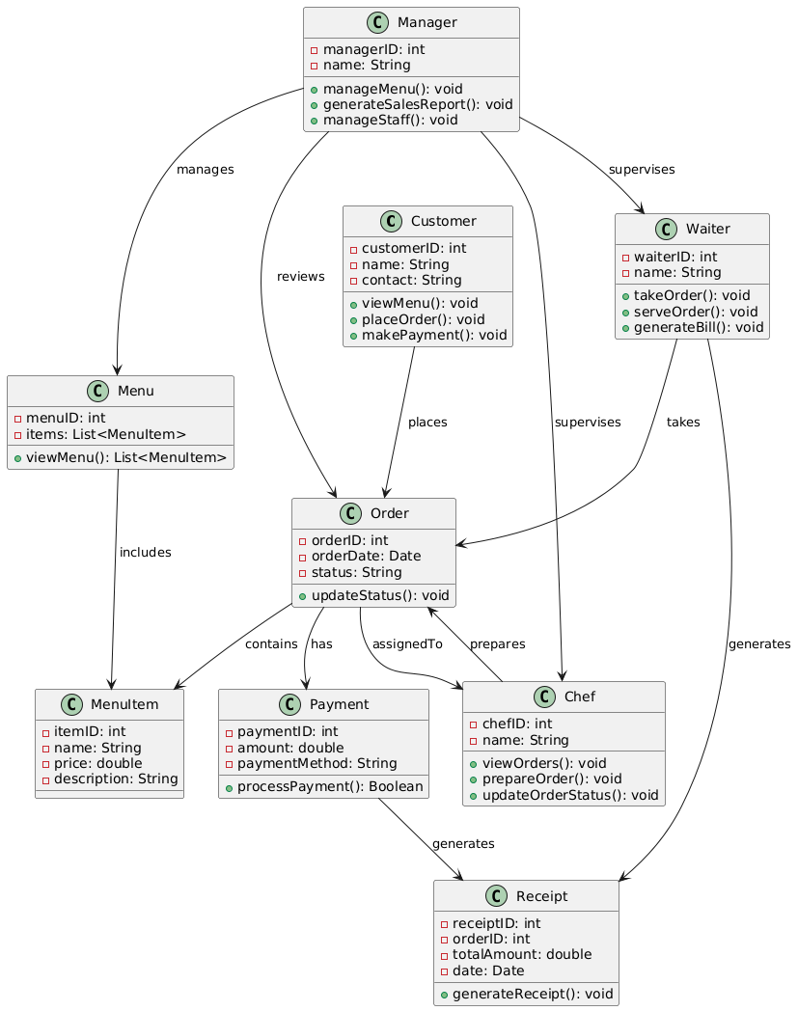
Domain Class Model Diagram

Slide 17
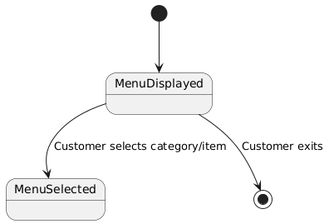
State Machine Diagram: View Menu

Slide 18
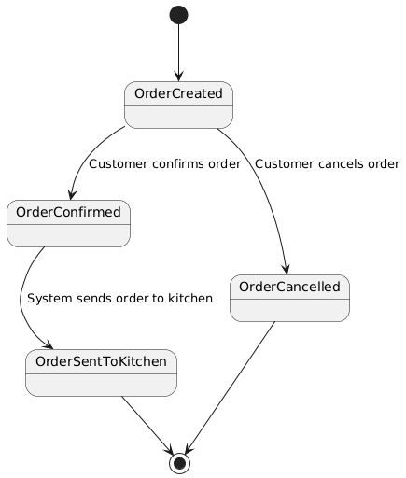
State Machine Diagram: Place Order

Slide 19
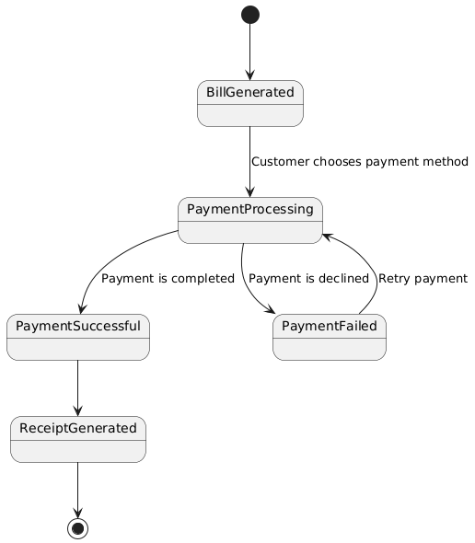
State Machine Diagram: Make Payment

Slide 20
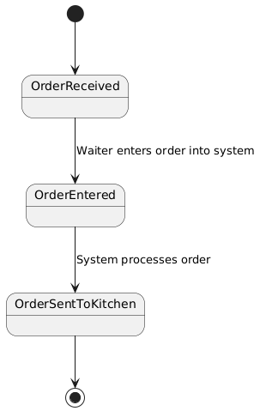
State Machine Diagram: Take Order

Slide 21
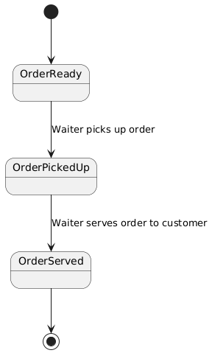
State Machine Diagram: Serve Order

Slide 22
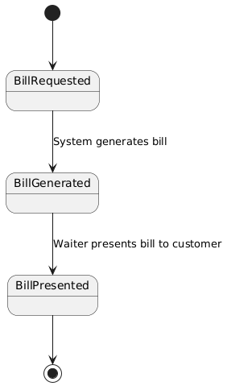
State Machine Diagram: Generate Bill

Slide 23
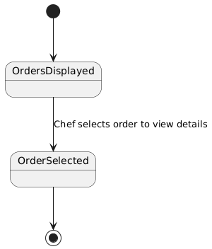
State Machine Diagram: View Orders

Slide 24
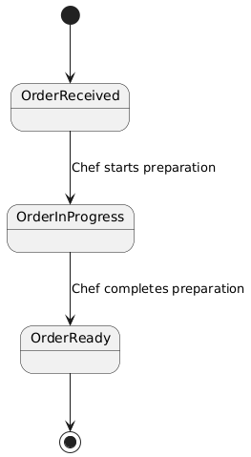
State Machine Diagram: Prepare Order

Slide 25
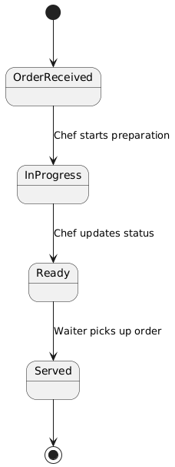
State Machine Diagram: Update Order Status

Slide 26
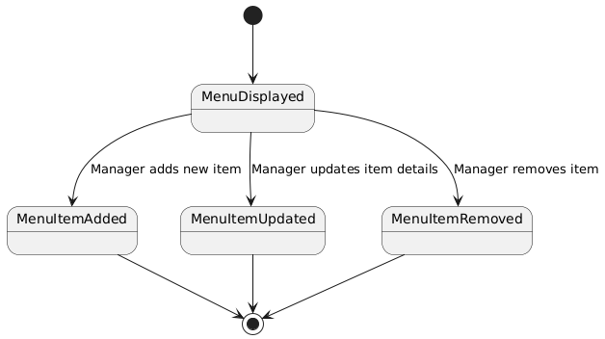
State Machine Diagram: Manage Menu

Slide 27
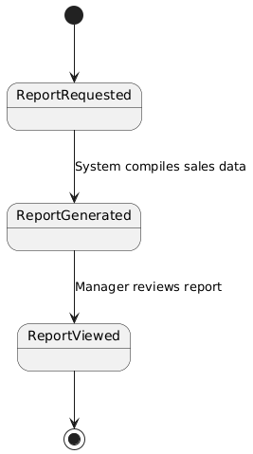
State Machine Diagram: Generate Sales Report

Slide 28
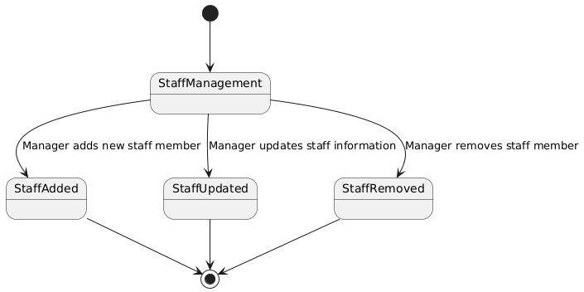
State Machine Diagram: Manage Staff

Slide 29
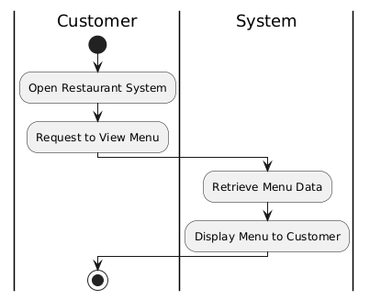
Activity Diagram: View Menu

Slide 30
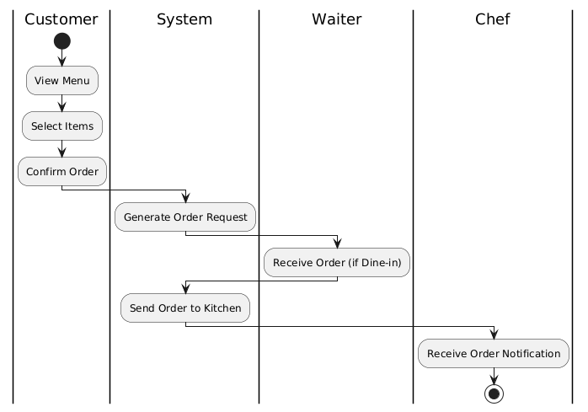
Activity Diagram: Place Order

Slide 31
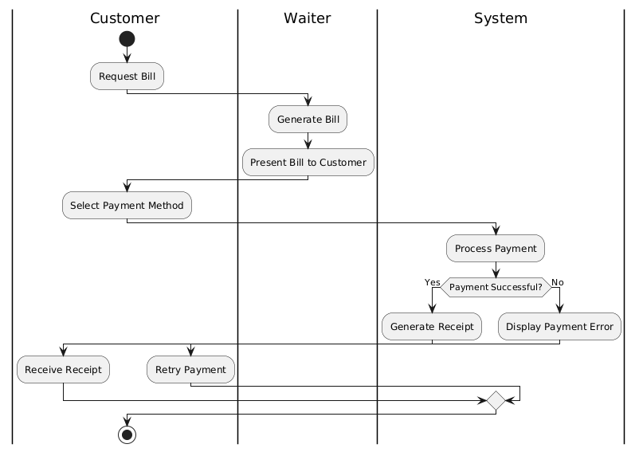
Activity Diagram: Make Payment

Slide 32
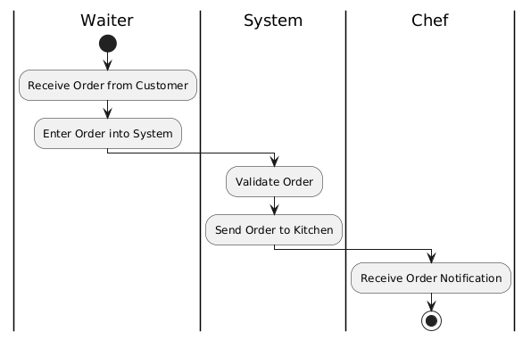
Activity Diagram: Take Order

Slide 33
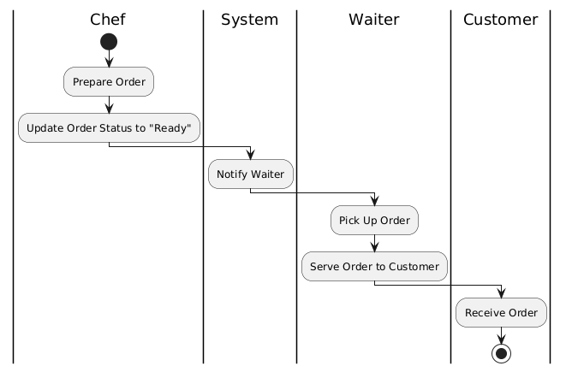
Activity Diagram: Take Order

Slide 34
Activity Diagram: Server Order

Slide 35
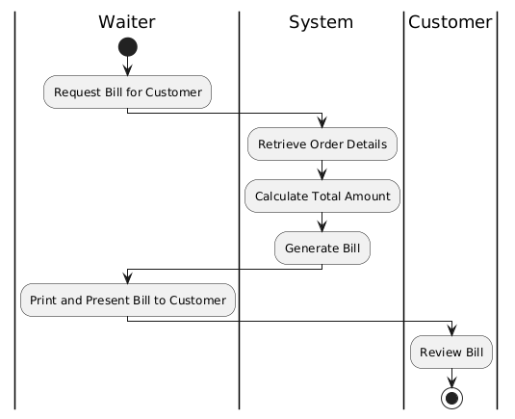
Activity Diagram: Generate Bill

Slide 36
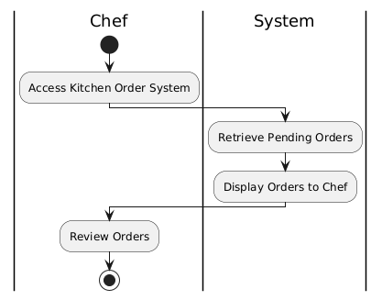
Activity Diagram: View Orders

Slide 37
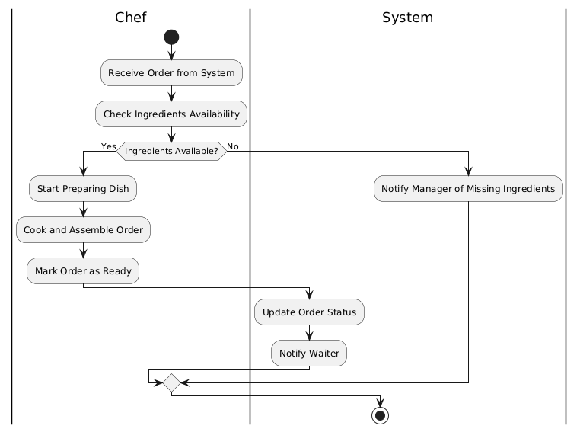
Activity Diagram: Prepare Order

Slide 38
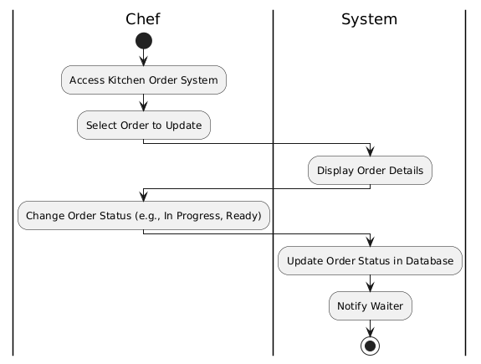
Activity Diagram: Update Order Status

Slide 39
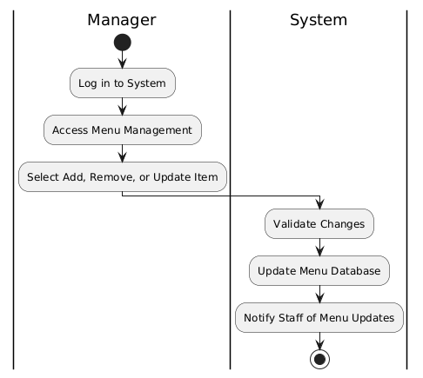
Activity Diagram: Manage Menu

Slide 40
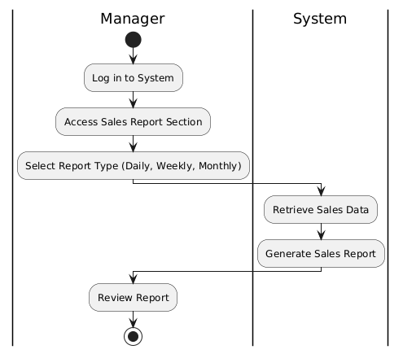
Activity Diagram: Generate Sales Report

Slide 41
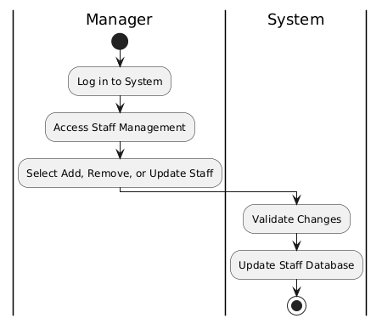
Activity Diagram: Manage Staff

Slide 42
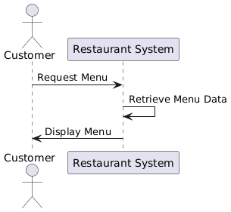
System Sequence Diagram: View Menu

Slide 43
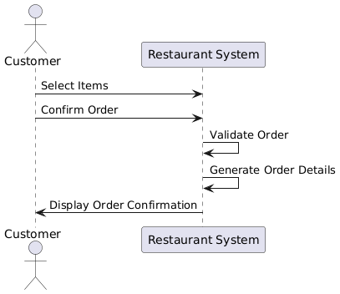
System Sequence Diagram: Place Order

Slide 44
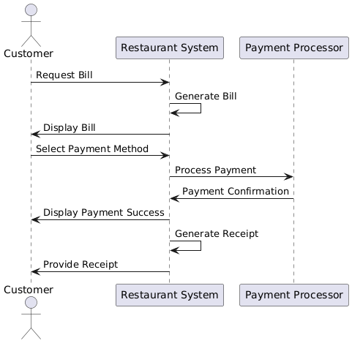
System Sequence Diagram: Make Payment

Slide 45
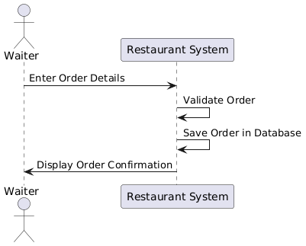
System Sequence Diagram: Take Order

Slide 46
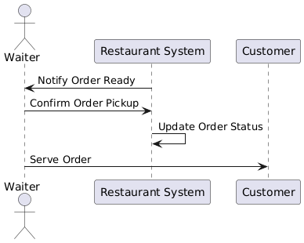
System Sequence Diagram: Serve Order

Slide 47
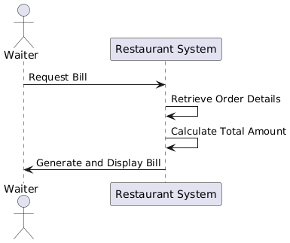
System Sequence Diagram: Generate Bill

Slide 48
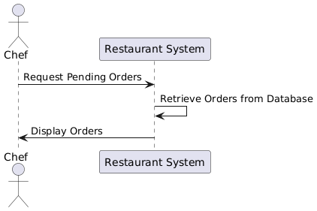
System Sequence Diagram: View Orders

Slide 49
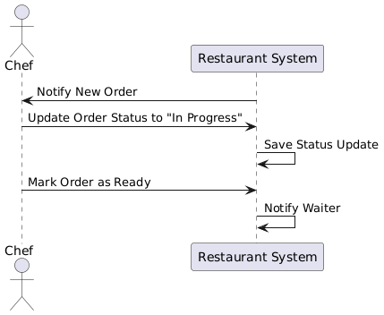
System Sequence Diagram: Prepare Order

Slide 50
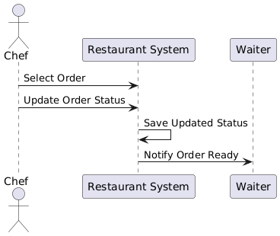
System Sequence Diagram: Update Order Status

Slide 51
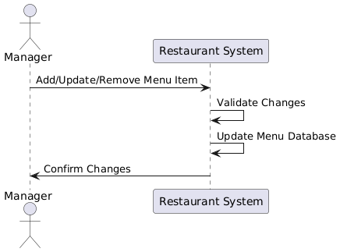
System Sequence Diagram: Manage Menu

Slide 52
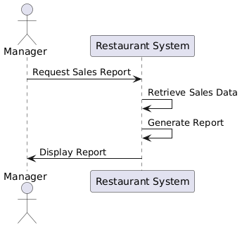
System Sequence Diagram: Generate Sales Report

Slide 53
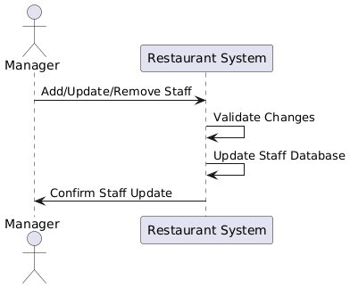
System Sequence Diagram: Manage Staff

Slide 54
CRUD Verification Table
Actor | CRUD | Verified Use Case
Customer | Create | Place order, Create customer account
 | Read | View menu
 | Update | Update customer information
 | Delete | Delete customer account

Slide 55
CRUD Verification Table
Actor | CRUD | Verified Use Case
Waiter | Create | Place order on behalf of customer
 | Read | View menu, View order
 | Update | Update order status
 | Delete | Cancel order

Slide 56
CRUD Verification Table
Actor | CRUD | Verified Use Case
Chef | Create | None
 | Read | View order
 | Update | Update order status
 | Delete | None

Slide 57
CRUD Verification Table
Actor | CRUD | Verified Use Case
Manager | Create | Add menu item, Add staff, Generate sales report
 | Read | View menu, View sales report
 | Update | Update menu, Update staff information, Refresh sales report
 | Delete | Remove menu item, Remove staff, Archive sales report

